Slide 1
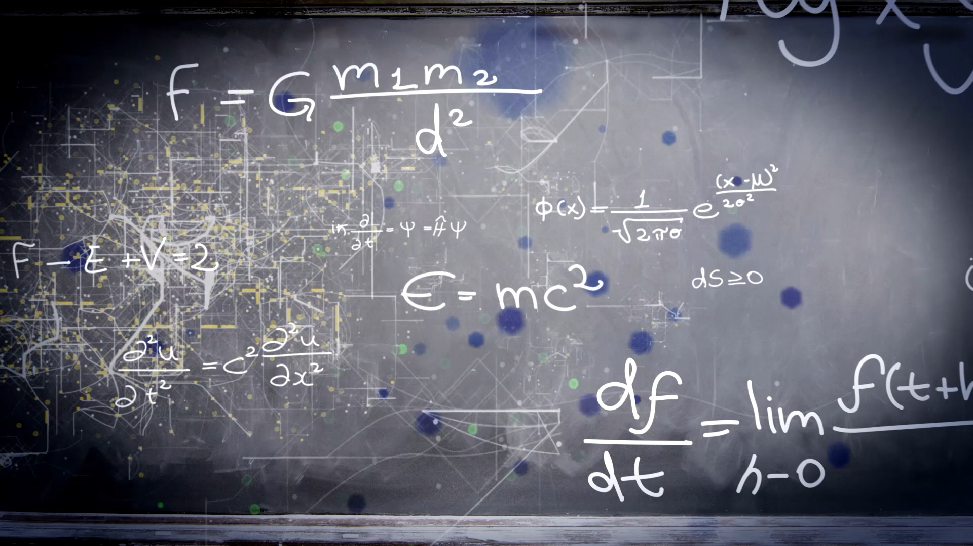
Introduction to Bayesian Age-depth models for ²¹⁰Pb

Slide 2
Outline
Probability and statistics
Bayesian inference
Age-depth models for ²¹⁰Pb
Bayesian approach
Comparison
Proxies?

Slide 3
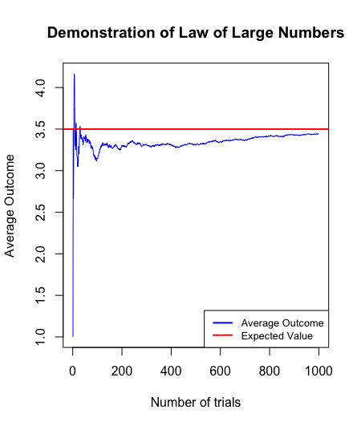
Difference between Probability and Stats
Probability theory provides a framework for quantifying uncertainty.
Main tools:
Random Variables (Density distributions)
Stochastic process (Non-deterministic processes)
Asymptotic convergence (Convergence of a process after many trials)

Slide 4
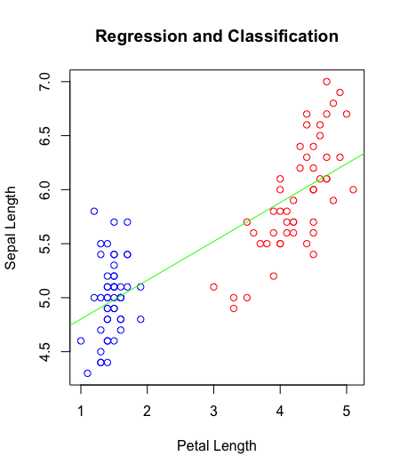
Difference between Probability and Stats
Statistics is the science of analysing and interpreting data.
Main tools:
- Hypothesis Testing (Test the parameters of a R.V)
- Inference (Obtain patters)
- Prediction (Define a patter in the data and extended to unmeasured sections)

Slide 5
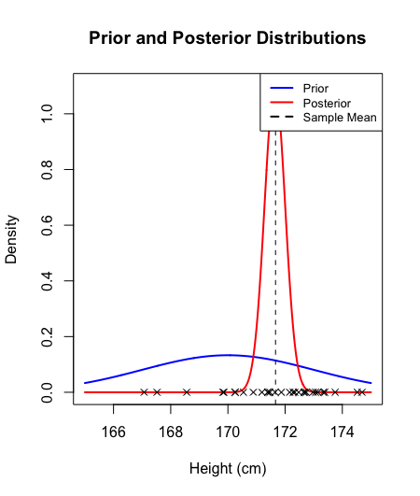
Bayesian Statistics
Bayesian statistics seamlessly connects probability theory and statistics. It uses probability to quantify uncertainty and make inferences from data
The principles of probability theory, as it assigns probabilities to any event or hypothesis.
The tools of statistics, as it involves parameters estimation, hypothesis testing, and prediction based on data.

Slide 6
Example
Let's assume that you take a COVID test, these test have false positive rates and false negative, lets assume in this example that these rates are 3% and 2% respectably. Now let’s assume that we have information that around 5% of the population was infected with COVID last month. Given no more information you take a COVID test.
Lets define the random variables as:
A = Having COVID
B= Positive test

Slide 7
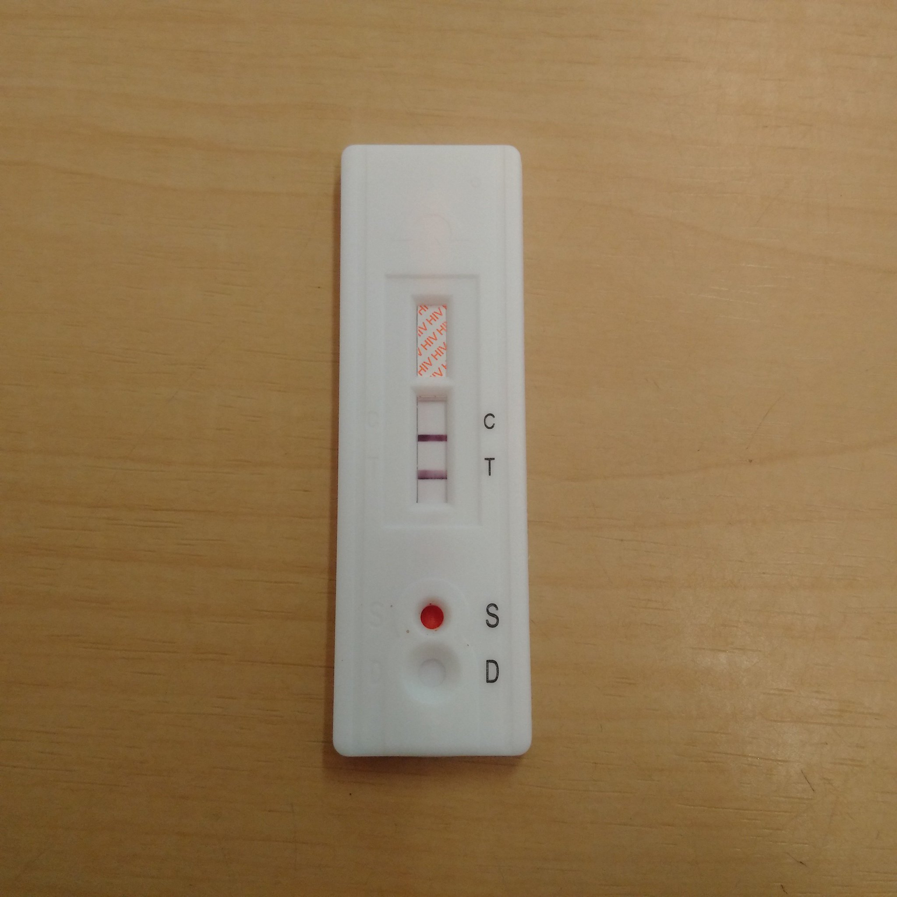
Calculating the posterior probability
P(A) = 0.05 (the prevalence of COVID-19 in the population, which is 5%) P(B|A) = 0.98 (the probability of a positive test result given that you have COVID-19, which is 98%)
P(B|A) = 0.03 (the probability of a positive test result given that you don’t have COVID-19, which is 3%)
Now you take the test, and such test come out positive.
Note: This is not the same has having COVID.

Slide 8
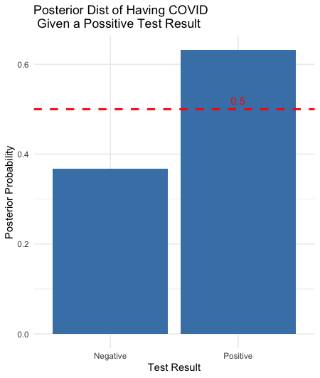
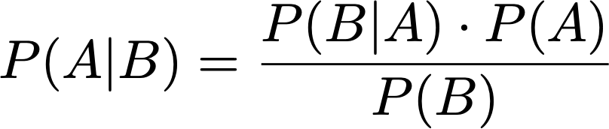
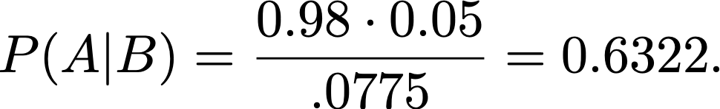
Posterior Distribution
Let's calculate the probability of having COVID given that the test came out positive.
Resulting in,

Slide 9
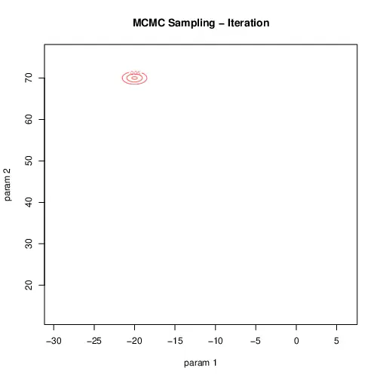
Markov Chain Monte Carlo
Markov Chain Monte Carlo (MCMC) is a computational method used in Bayesian statistics.
MCMC approximates and samples from complex posterior distributions.
MCMC is valuable when analytical computation of the posterior is challenging or intractable.

Slide 10
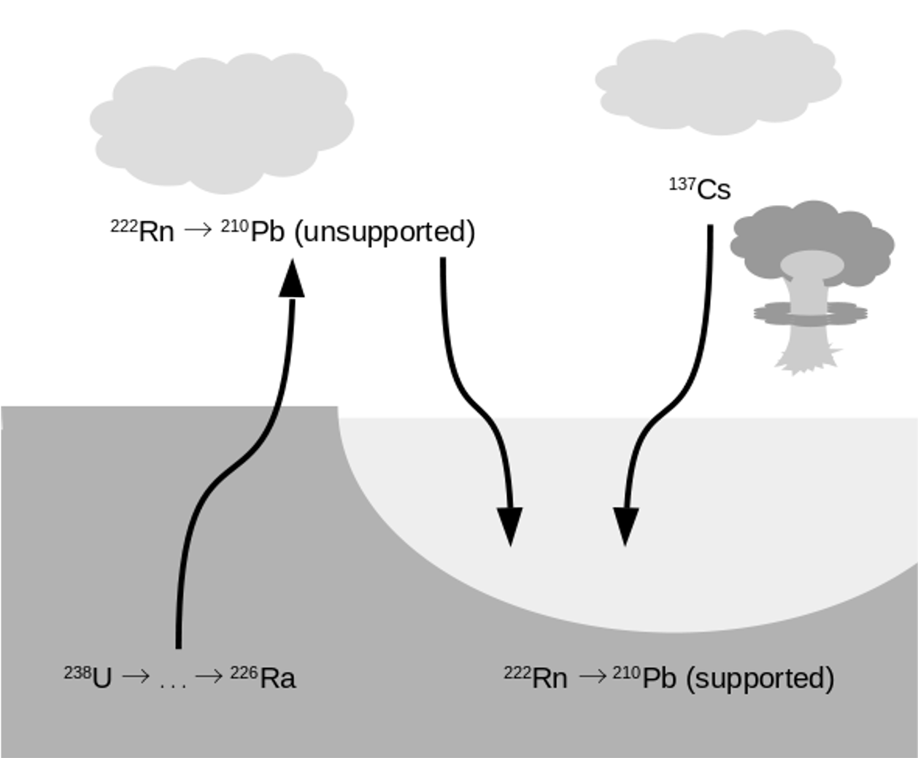
Age-depth models for ²¹⁰Pb

Slide 11
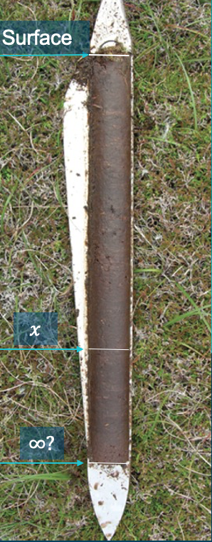
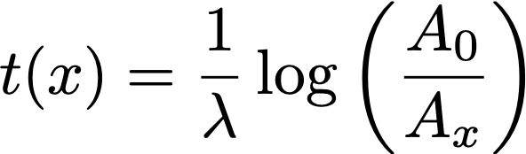
Age-depth models for ²¹⁰Pb
This model assumes a constant rate of supply of 210Pb to the sediment in the period of interest.
Created by
Appleby & Oldfield (1979) Robbins (1979)

Slide 12
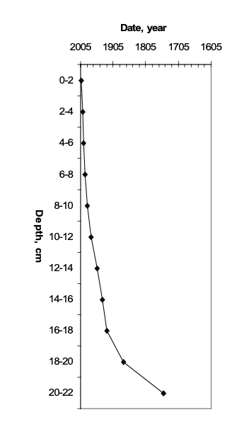
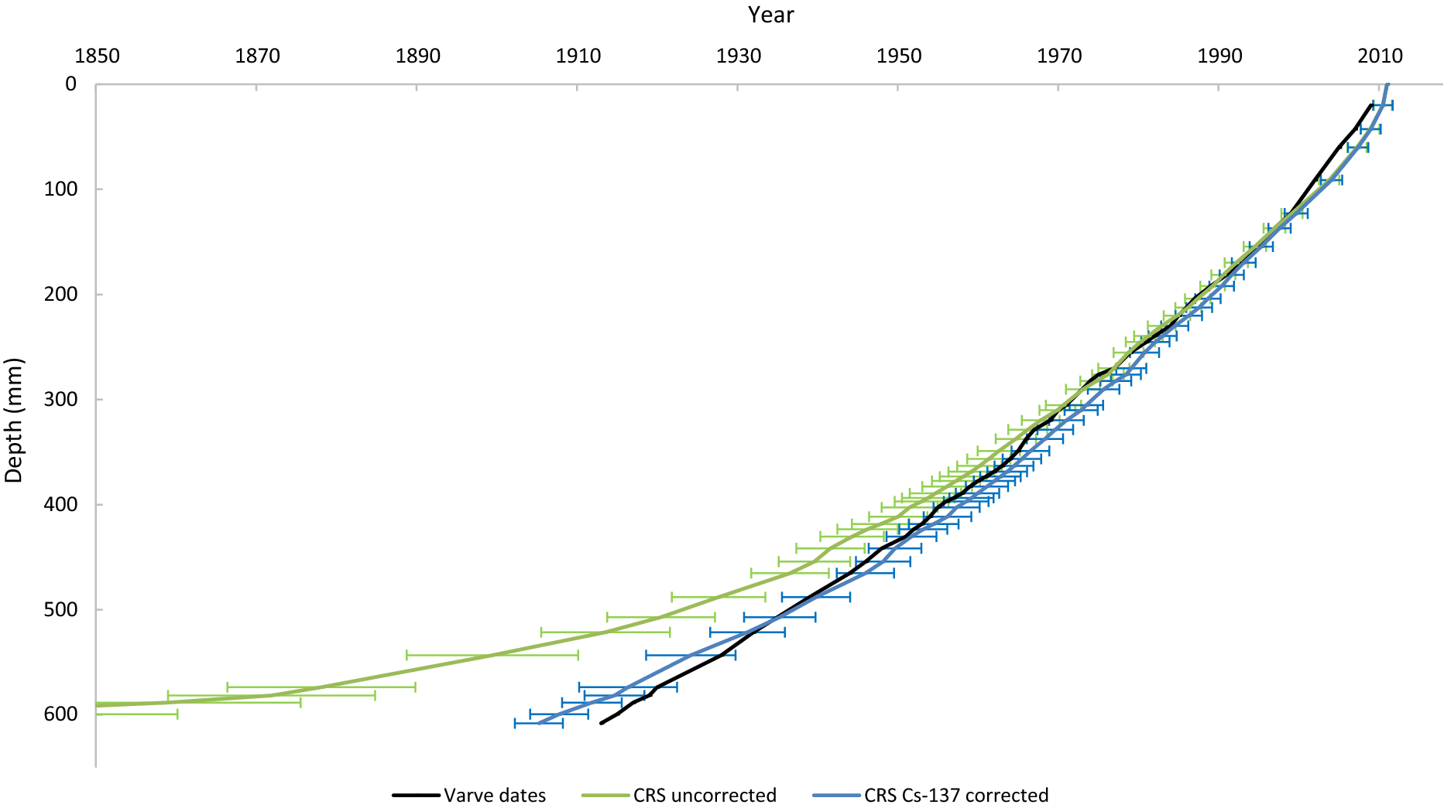
CRS examples
To the left a sample from 2006
To the right a sample from 2023
Hunter et al. (2023)
Lubis (2006)

Slide 13
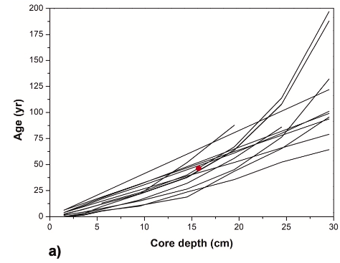
²¹⁰Pb dating of same core
“The exercise involved 14 laboratories worldwide with different levels of expertise in the application of the 210Pb dating methods.”
Barsanti et al (2020)
Barsanti et al. (2020)

Slide 14
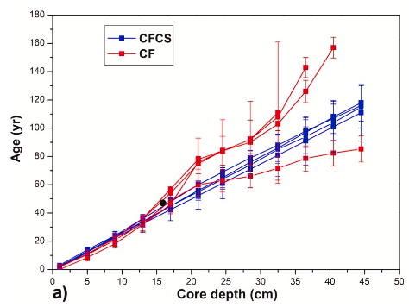
²¹⁰Pb dating of same core
Barsanti et al. (2020)

Slide 15
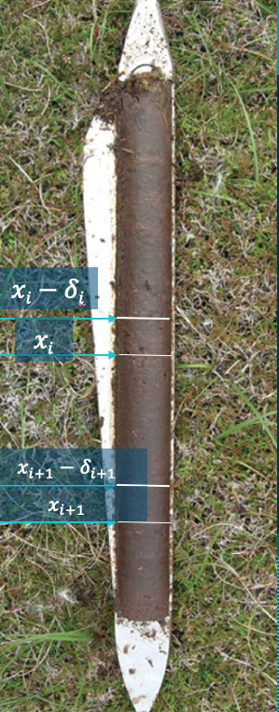
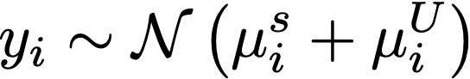
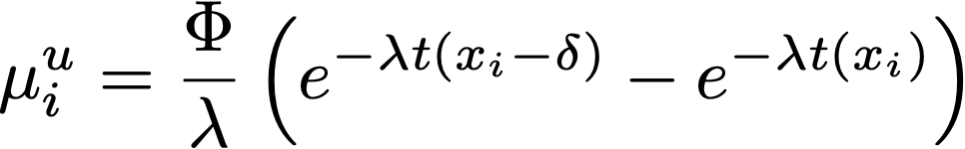
Plum
Plum works by implementing a statistical approach to creating the chronology. Plum defines the toral measured 210Pb as
With,

Slide 16
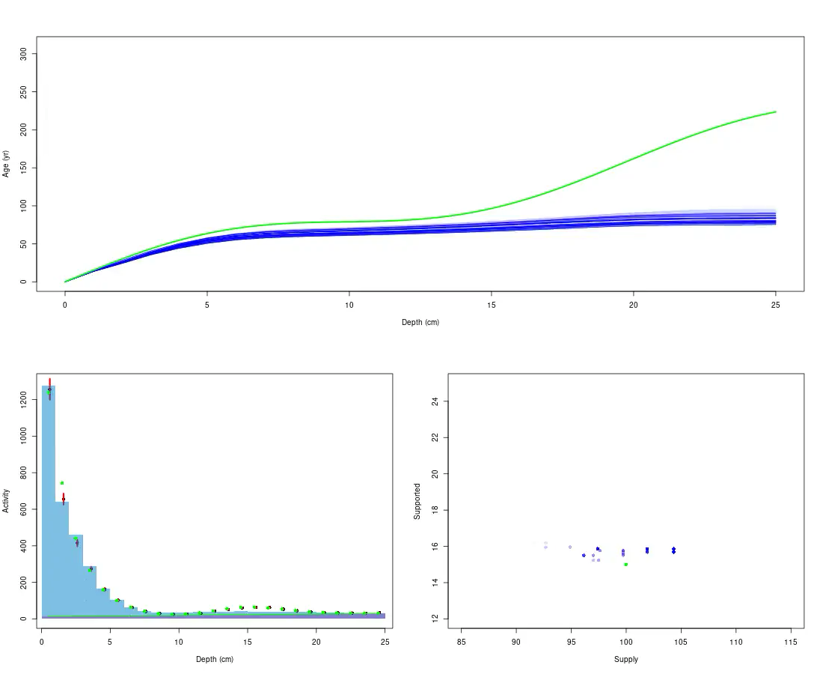
How does plum work
Simulation of the MCMC with in Plum

Slide 17
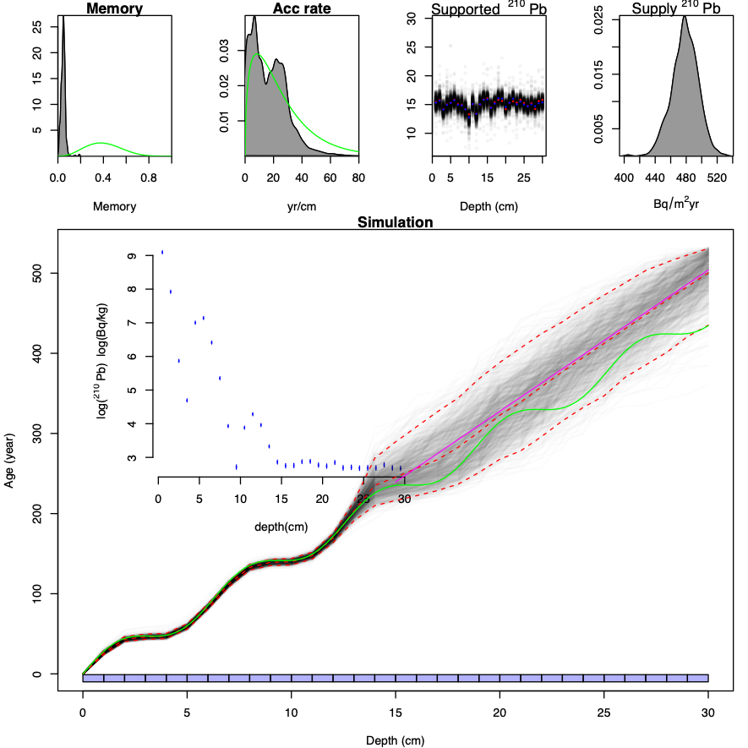
Plum examples

Slide 18
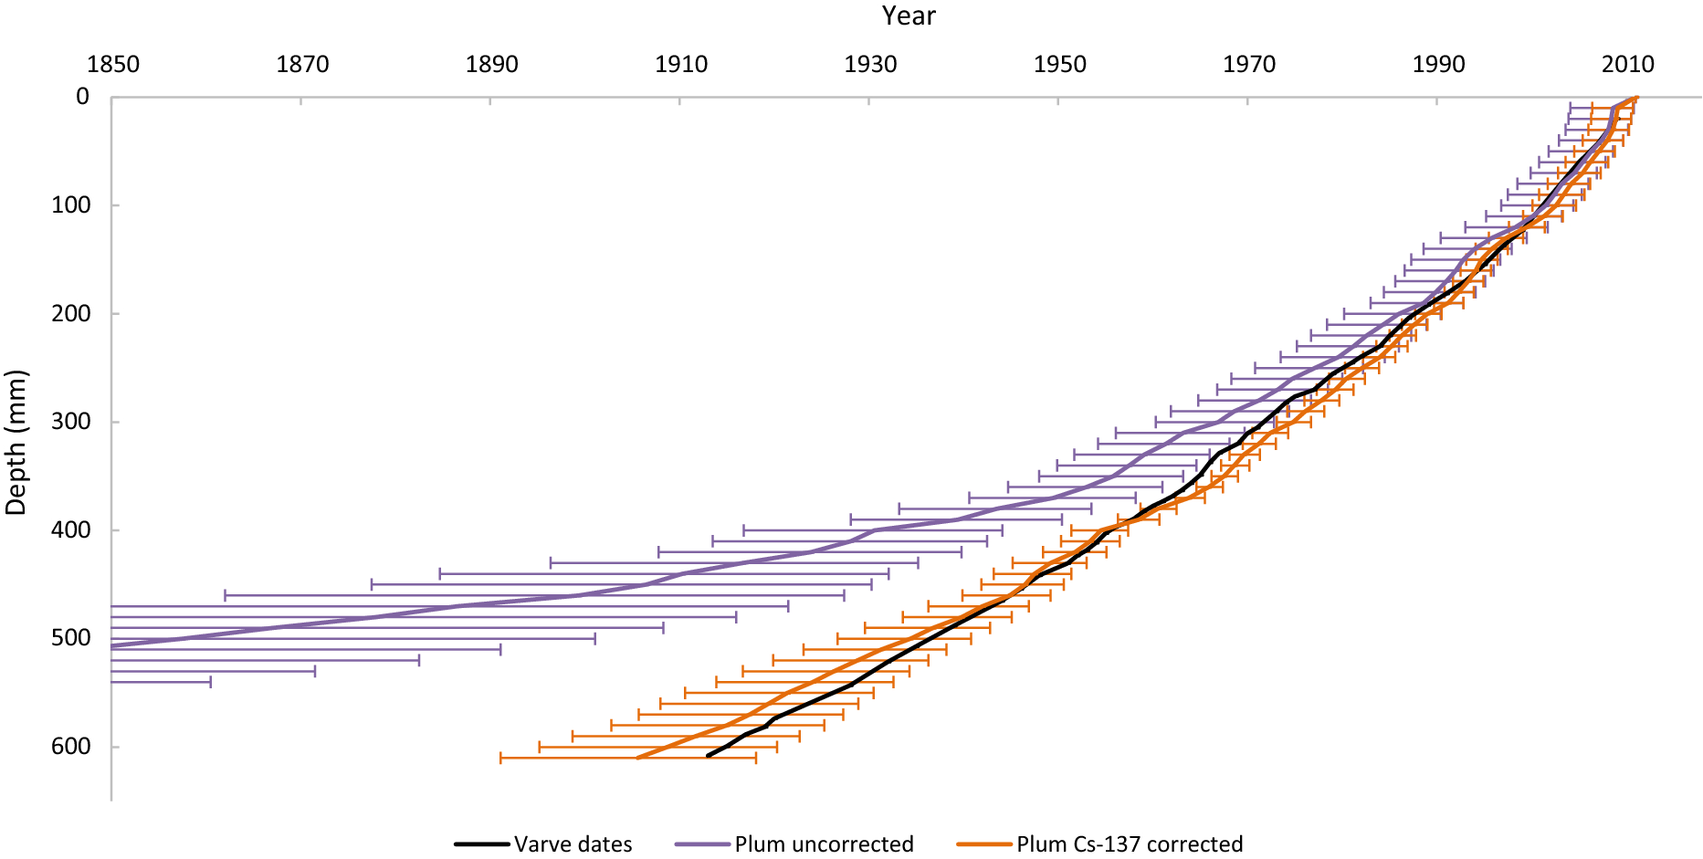
Plum example
Hunter et al. (2023)

Slide 19
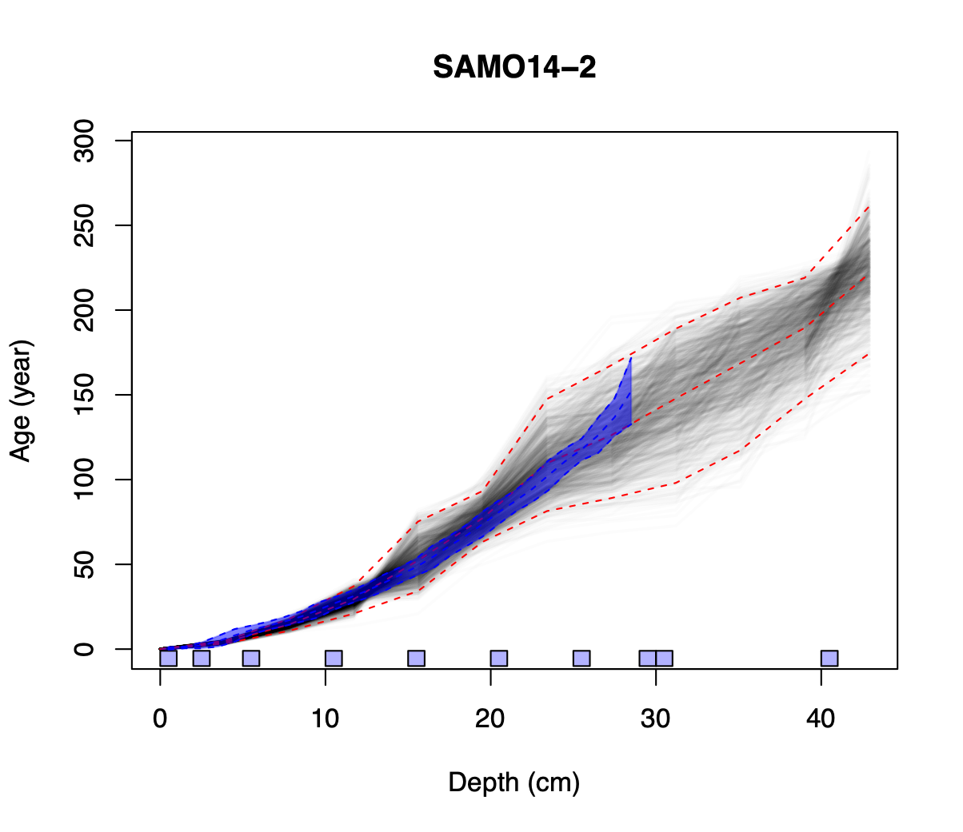
CRS-Plum comparison

Slide 20
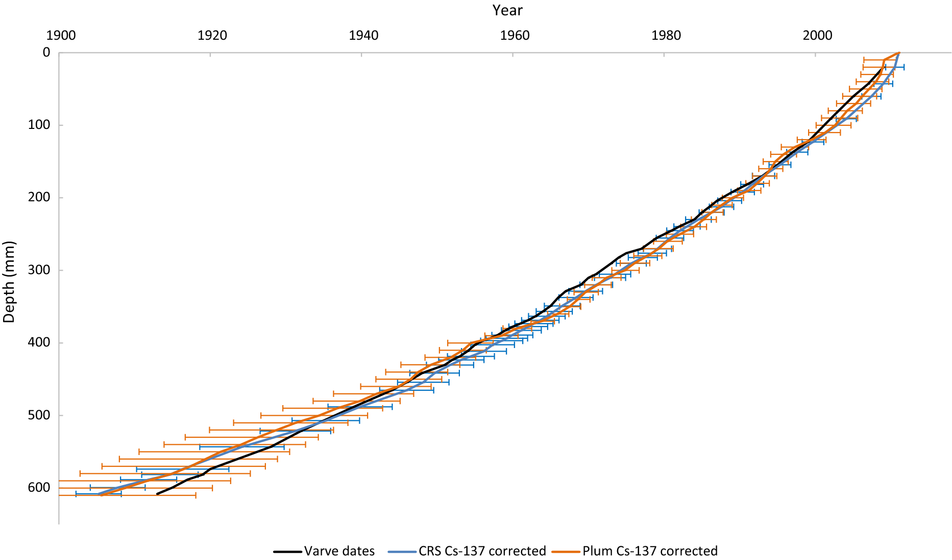
CRS-Plum comparison
Hunter et al. (2023)

Slide 21
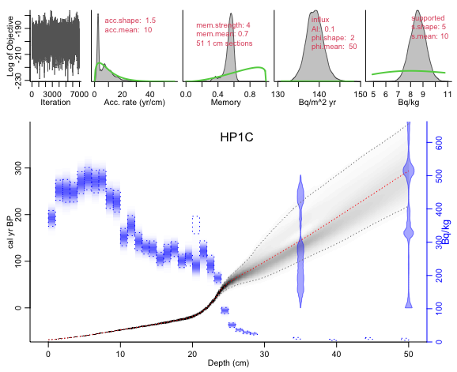
Plum with multiple data sources

Slide 22
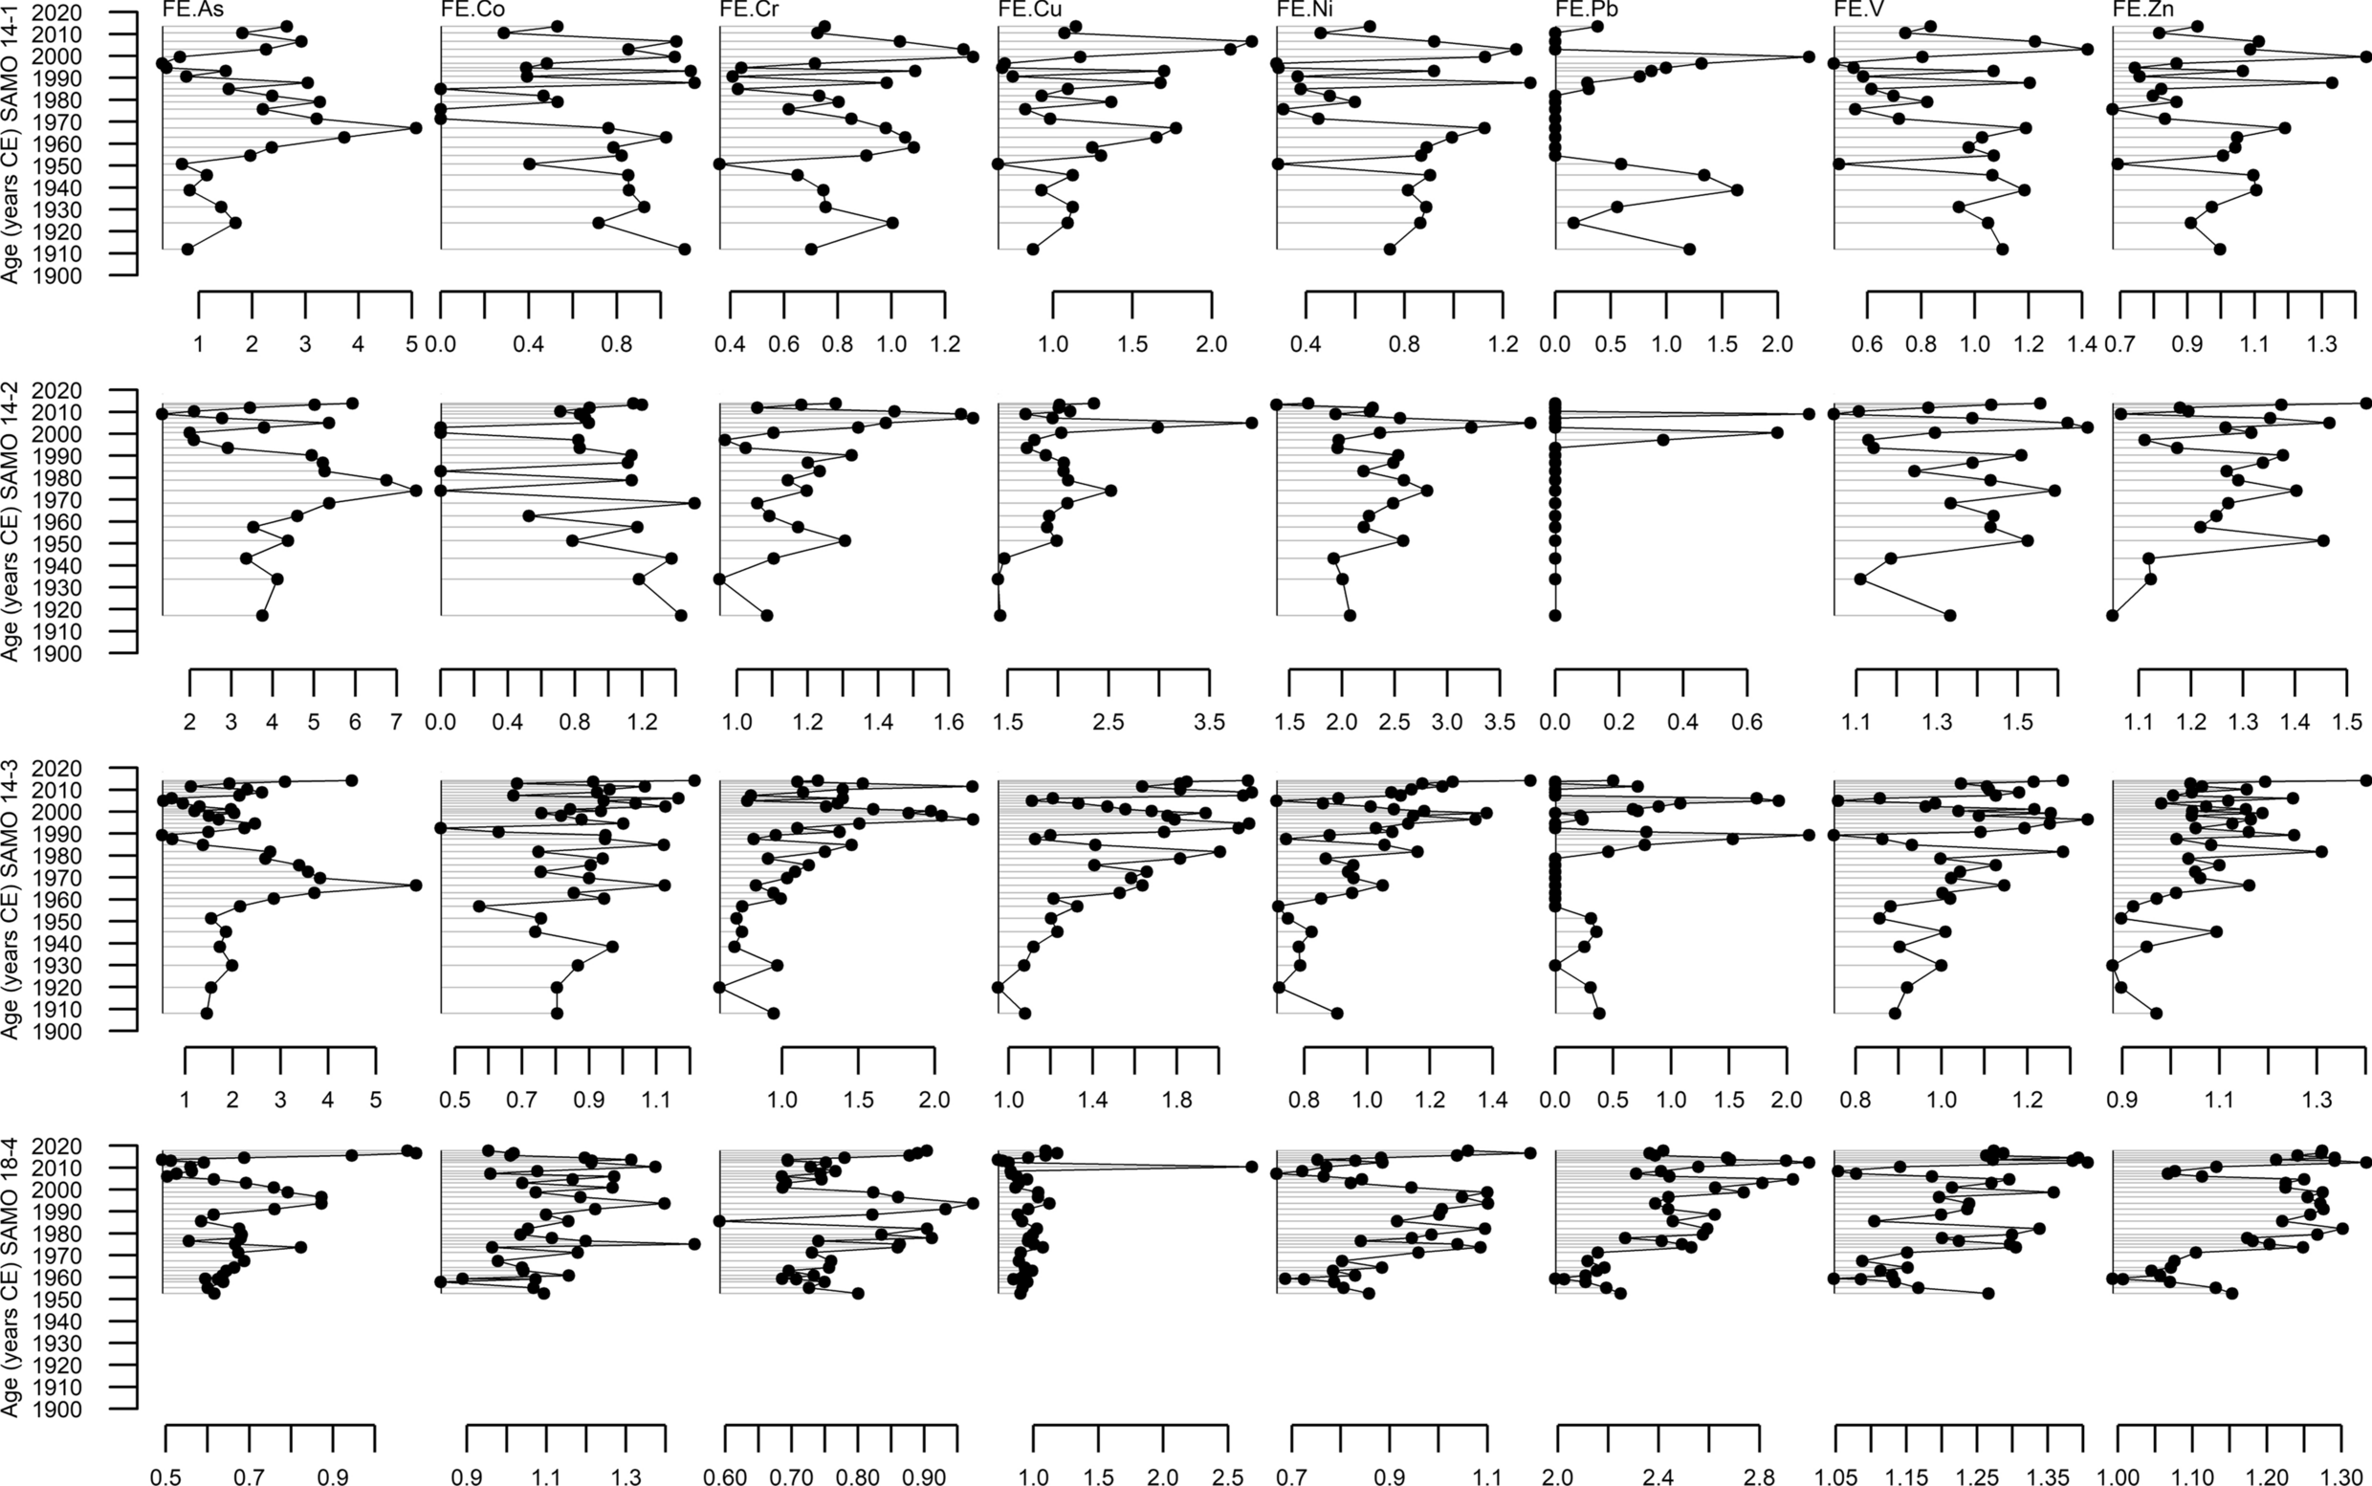
PROXIES?
Ruiz-Fernandez et al. (2023)

Slide 23
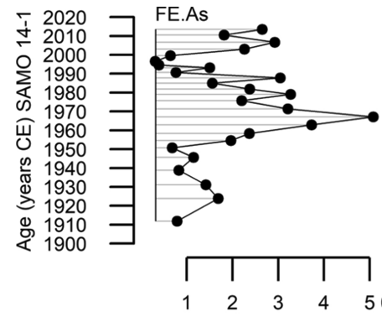
Proxy in the age scale
What happened to the uncertainty?
What if my age-depth model was wrong?
What should I do?
😖
Ruiz-Fernandez et al. (2023)

Slide 24
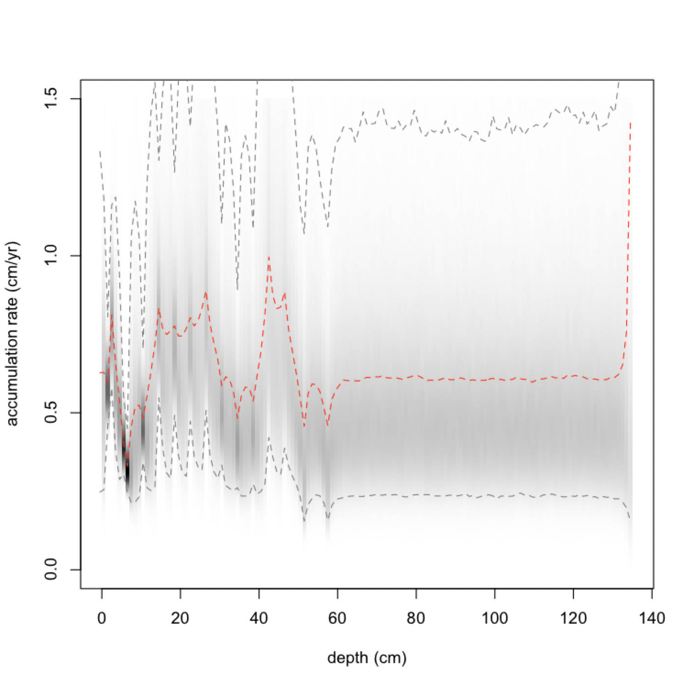
Bacon/Plum GhostPlots

Slide 25
PUlQUe (work in progress)

Slide 26
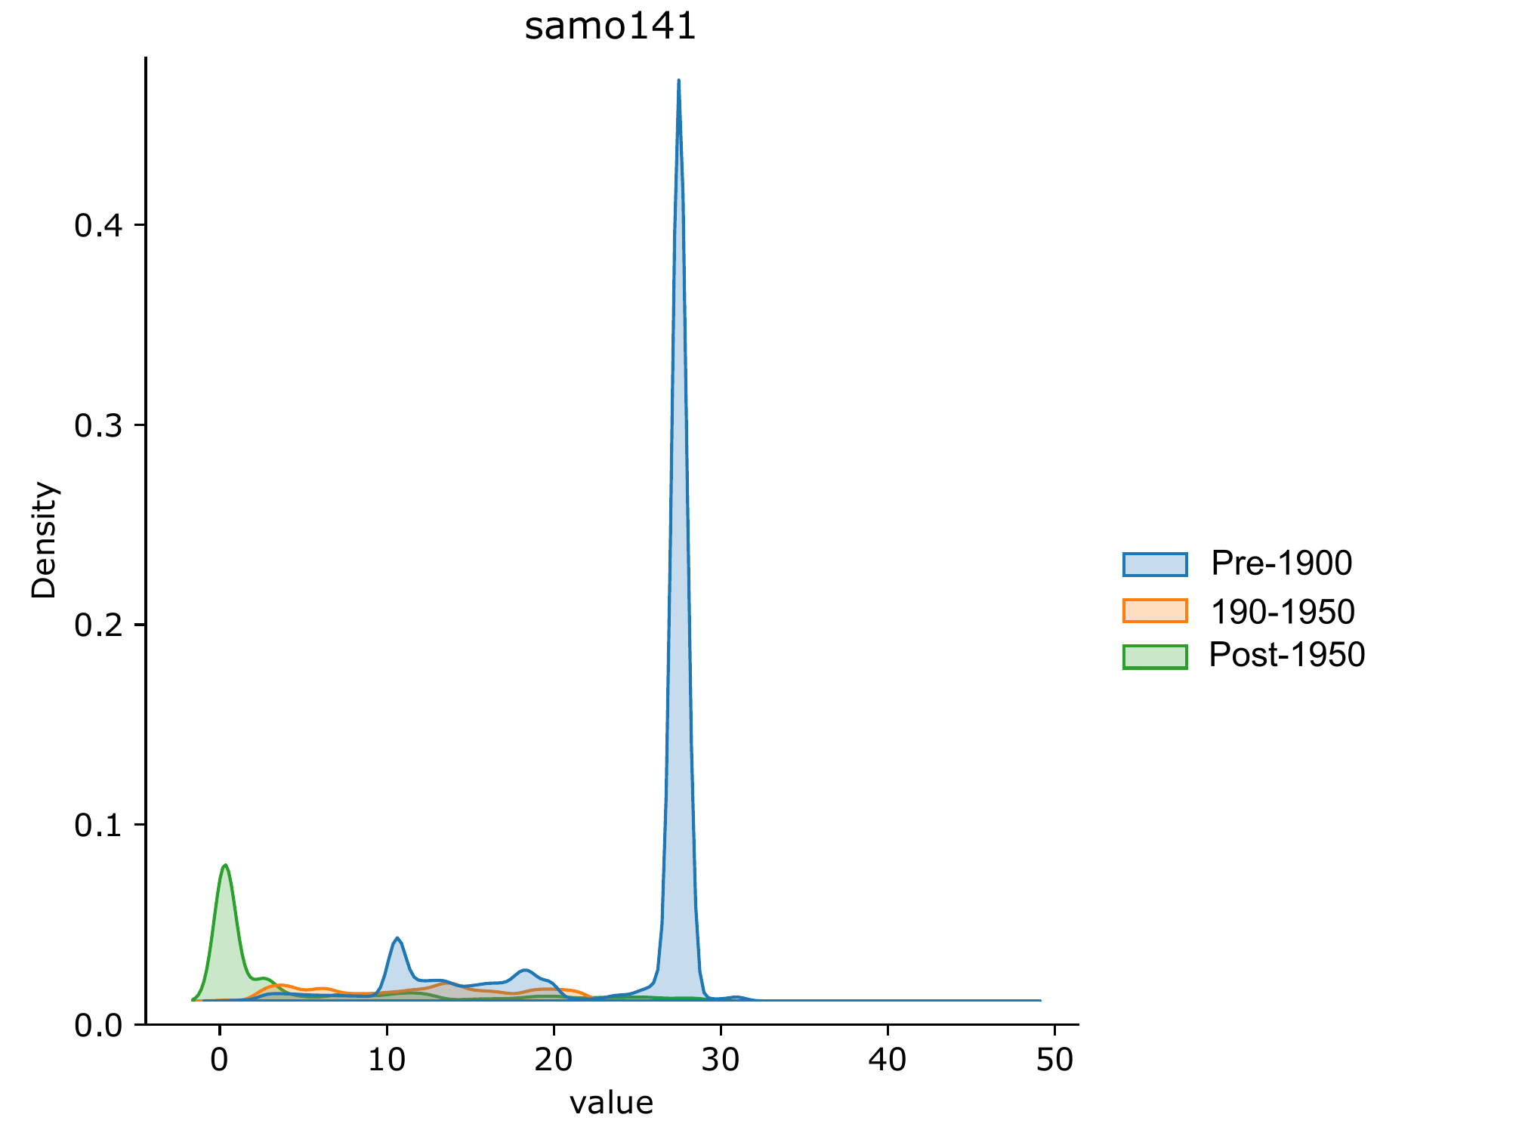
Posterior Probabilities

Slide 27

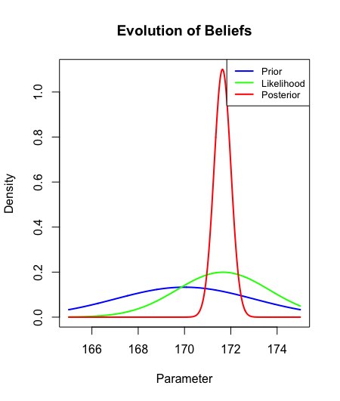
Gracias
Appleby, P., and Oldfield, F. 2005. The calculation of lead-210 dates assuming a constant rate of supply of unsupported 210Pb to the sediment. CATENA. 5:1-8
Aquino-López, M.A., Blaauw, M., Christen, J.A. et al. Bayesian Analysis of 210210Pb Dating. JABES 23, 317–333 (2018).
Hunter, H.N., Gowing, C.J.B., Marriott, A.L. et al. Developments in Pb-210 methodologies to provide chronologies for environmental change. Environ Geochem Health 45, 1173–1181 (2023).
Lee, P. M. (2012). Bayesian Statistics (4th ed.) . Nashville, TN: John Wiley & Sons.
Ruiz-Fernández, A.C., Sanchez-Cabeza, J.A., Pérez-Bernal, L.H. et al. Recent trace element contamination in a rural crater lake, NW Mexico. J Paleolimnol 69, 191–212 (2023).

